Slide 1
Company Sales Analysis
Group 1
David Gayman
Milad Nazar
Ibrahima Diallo
Jonathan Feldmann
Jacinta Oduor
Notes:
MILAD
-Group 1 presentation( read names of Team Members)
-Homework Title-ATLAS, named after the company source of data
-Slide template- obtained from the GWU website

Slide 2
Outline
Project Introduction
Data & Resources Gathering
Data Cleanup & Exploration
Data Analysis
Discussions & Key Conclusions
Q&A
Notes:
MILAD

Slide 3
Project Introduction
Motivation
Opportunity to provide data analysis for a sales scenario.
Hypothesis
A thorough data analysis has the ability to identify factors associated with high levels of sales and conversions, as well as provide projections of future income.
Notes:
MILAD
-Besides doing the project in fulfilment of the course requirement, our main motivation for selecting this project was to test the knowledge gained so far by using real data from one of the team member’s business. The hypothesis – the analysis of the company data will demonstrate the business trends i.e. geographical coverage , highest income customers/months/years and factors influencing these trends and lead to positive recommendations for the business. The summary represent the contents of the presentation, the process , findings and conclusions.
- The answer to our hypothesis will be addressed during the presentation on data analysis.
We shall take questions at the end of the presentation.

Slide 4
Project Introduction
Company Profile
Provides a subscription-based service.
Provides subscription terms ranging from one month to three years.
Has recently experienced an uptick in sales due to pandemic-related factors.
Notes:
MILAD
-Besides doing the project in fulfilment of the course requirement, our main motivation for selecting this project was to test the knowledge gained so far by using real data from one of the team member’s business. The hypothesis – the analysis of the company data will demonstrate the business trends i.e. geographical coverage , highest income customers/months/years and factors influencing these trends and lead to positive recommendations for the business. The summary represent the contents of the presentation, the process , findings and conclusions.
- The answer to our hypothesis will be addressed during the presentation on data analysis.
We shall take questions at the end of the presentation.

Slide 5
Project Introduction
Key Questions
(a) "What trends and patterns can be identified from the data?"
(b) “What aspects of compliance and due diligence are in place to protect disruption of business?”
(c) “Is the company targeting the highest-responding customers?”
(d) “What unforeseeable factors are likely to affect future sales?”
(e) “What market penetration does the company have into potential customers?”
(f) “What market penetration does the company have regionally?”
(g) “How are the highest paying and highest responding customers identified and classified?”
(h) “What lessons have been learned during the analysis?”
(i) “What recommendations are suggested to ensure increased future sales?”
(j) “What is a likely projected range of future sales?”
Notes:
MILAD

Slide 6
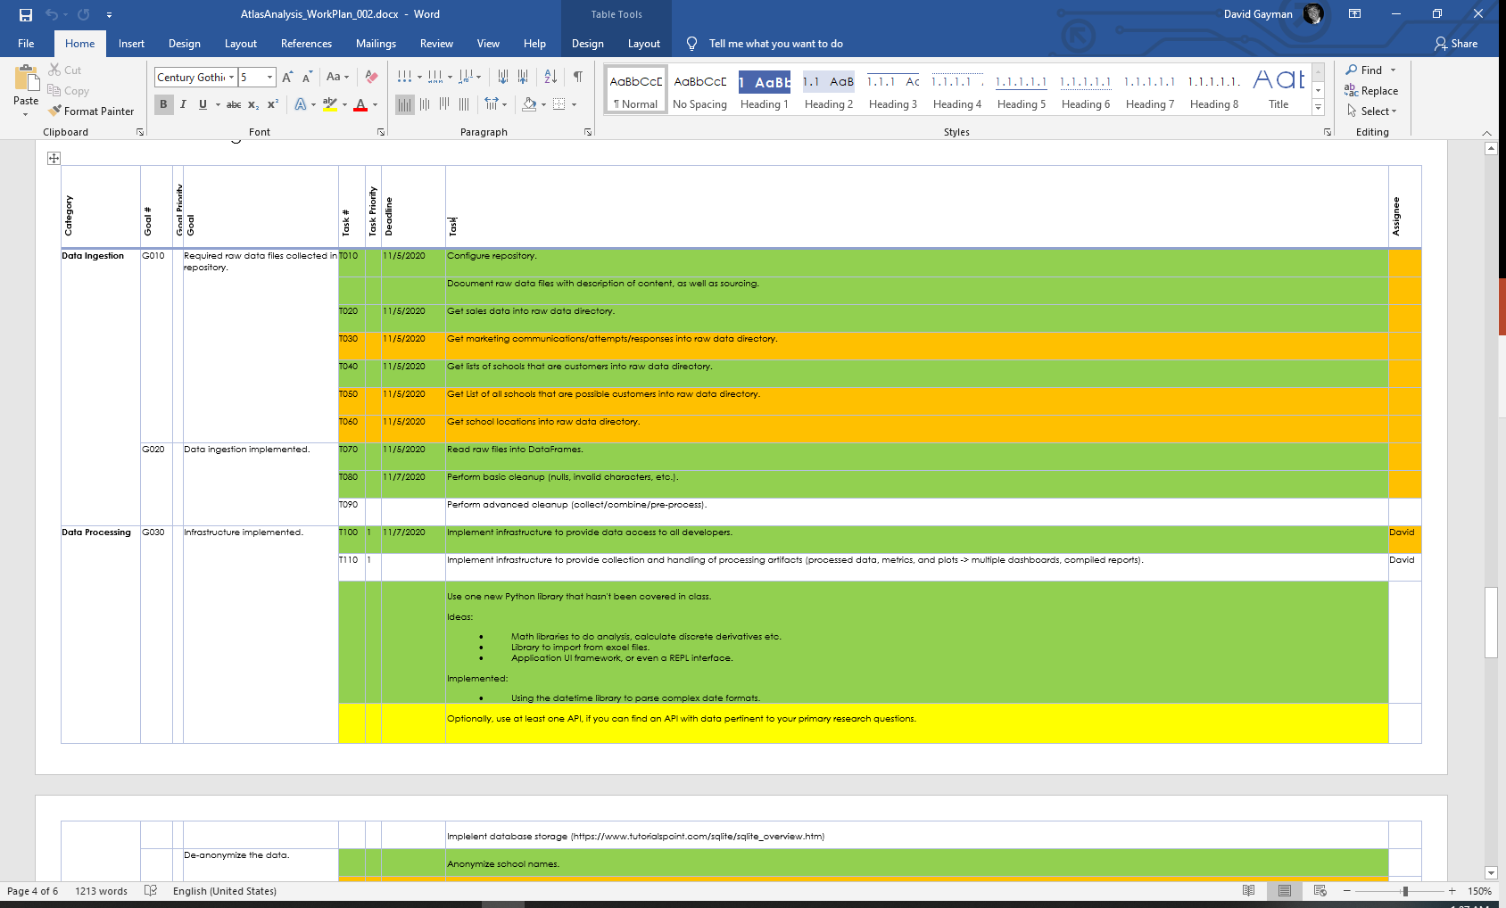
Project Introduction
Deliverables
Project Proposal & Work Plan
ReadMe File
Presentation
Dashboard
Notes:
JACINTA
-The project instructions was to create a number of products/deliverables and this slide shows the list of what the team worked on and the results
- i.e the deliverables which are ……. in number ( if possible you can display them)

Slide 7
Project Introduction
Solution Approach
Identified key questions and prepared a Work Plan.
Obtained data from the customer.
Accomplished work through team discussions, individual contributions, pair programming.
Notes:
JACINTA
-This slide describes the process or approach the team undertook to accomplish the task
-A team member volunteered to secure data from his employer( NBTS) National Board for Professional Teaching Standards, https://www.nbpts.org/ explain nature of business and what data represent
-Release of data and confidentiality agreement was secured- so data is real and reflect an ongoing business.
-Workplan prepared describe tasks to be performed, data cleaning, plots, time lines and prioritization -the colors identify the order of importance-dark orange being most important-ast taks got completed colors were changed to green
-Timelines we met by working during the class sessions and teams separate sessions in between- there was good team synergy throughout
- A repo for the team project and branches were created in each team member Github with branches and updated at the end of each discussion sessions

Slide 8
Data & Resources Gathering
Raw data sourced and collected into Resources/Raw repository directory.
Raw files exported to .csv in the Raw directory.
Notes:
DAVID

Slide 9
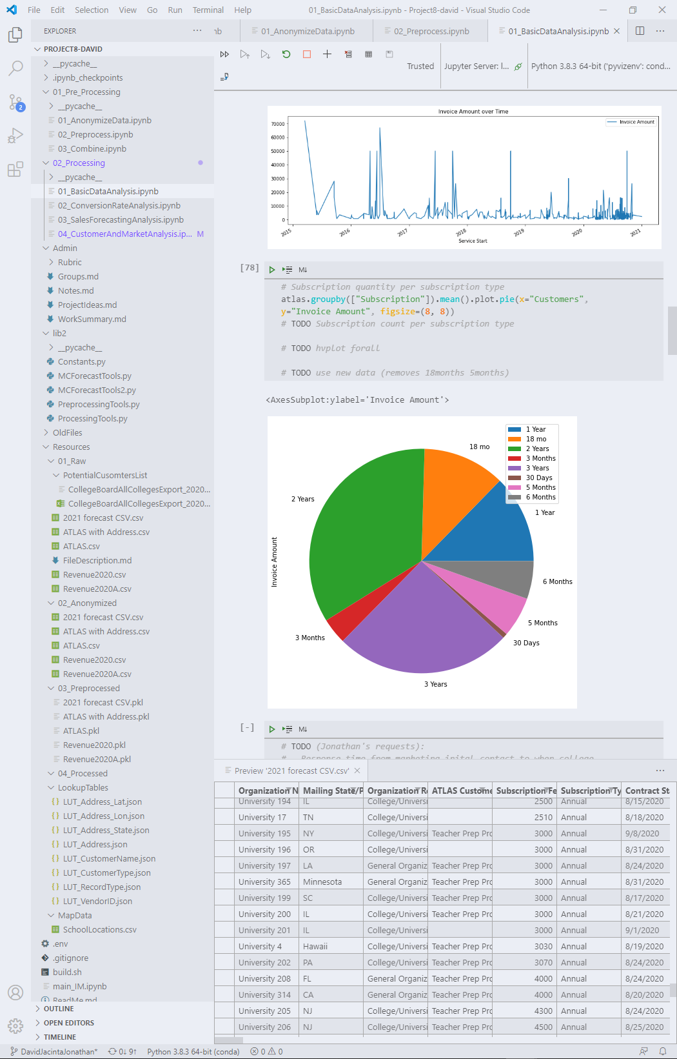
Data Cleanup & Exploration
Technologies
Python was used inside Jupyter Lab notebooks to provide dynamic data analysis.
File Organization
Data files placed in Resources.
Jupyter notebooks organized by processing stage.
Data shared across notebook collection via binary files containing serialized (pickled) DataFrames.
Tools implemented in shared Python class files.
Notes:
DAVID
Resources files are 4 with the main one called ATLAS-( name of project)
Anonymizing data was critical for confidentiality obligation- to do this- we used ( explain plot used and show on dashboard)
Data Cleaning included:-
Configure repository.
Document raw data files with description of content, as well as sourcing.
Get sales data into raw data directory.
Get marketing communications/attempts/responses into raw data directory.
Get lists of schools that are customers into raw data directory.
Get List of all schools that are possible customers into raw data directory.
Get school locations into raw data directory.
Read raw files into DataFrames.
Perform basic cleanup (nulls, invalid characters, etc.).
Perform advanced cleanup (collect/combine/pre-process).
Implement infrastructure to provide data access to all developers.
Implement infrastructure to provide collection and handling of processing artifacts (processed data, metrics, and plots -> multiple dashboards, compiled reports).
Use one new Python library that hasn't been covered in class (math) (import from excel files!!!).

Slide 10
Data Cleanup & Exploration
Processing Stages
Raw Data: Raw unprocessed data.
Anonymized: Raw data with customer names anonymized.
Pre-processed: Preprocessed, cleaned data.
Processed & LookupTables: Processed data including lookup tables generated from preprocessed data to enhance data merging.
Notes:
DAVID

Slide 11
Data Analysis: General Analysis
(a) “What trends and patterns can be identified from the data?”
Notes:
JONATHAN

Slide 12
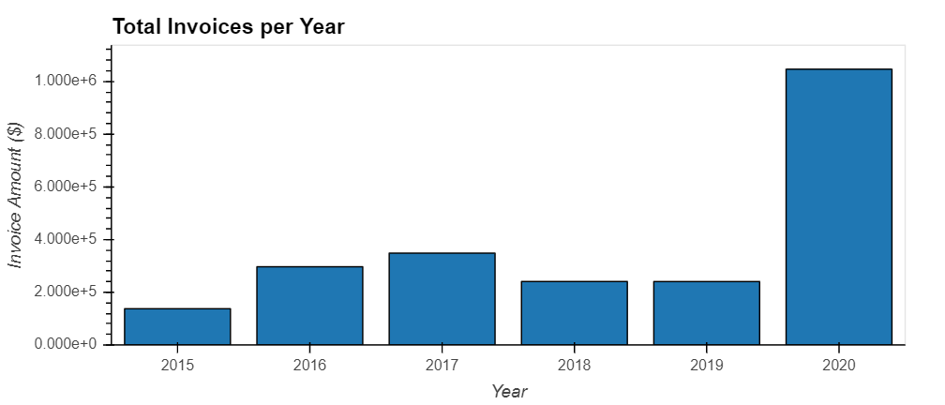
Data Analysis: General Analysis
Sales Increase in 2020
Notes:
JONATHAN
-Covid has led to significant uptick in the number of individuals interested in this subscription service.
- We also see a decrease in sales from 2017 - 2018
-Explain plot used here
-Again same scenario subscription sales highest in 2020 in the 5 year period
-Explain code used to plot these two block charts
- Identify what the objective of the plot is-period & invoice
- conclusion?
a year 2020 showed highest returns/subscription sales- any correlation with the pandemic-more on this in the key recommendation slide
b subscription highest average is in the month of August-any correlation with school/college calendar?

Slide 13
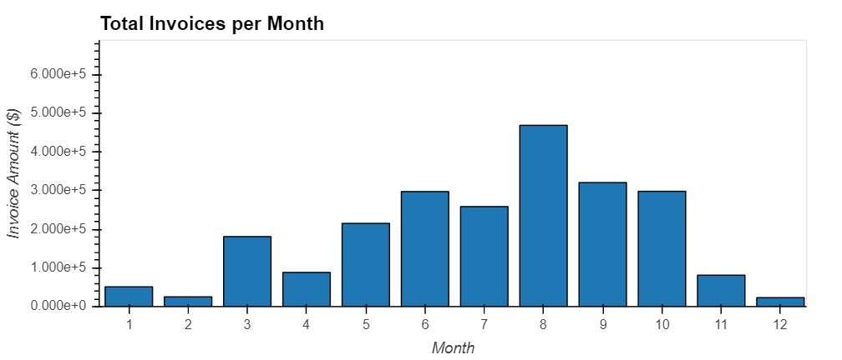
Data Analysis: General Analysis
Best-Selling Months (2015 – 2020)
Notes:
JONATHAN
-Explain plot used here
-Again same scenario subscription sales highest in 2020 in the 5 year period
-Explain code used to plot these two block charts
- Identify what the objective of the plot is-period & invoice
- conclusion?
a year 2020 showed highest returns/subscription sales- any correlation with the pandemic-more on this in the key recommendation slide
b subscription highest average is in the month of August-any correlation with school/college calendar?

Slide 14
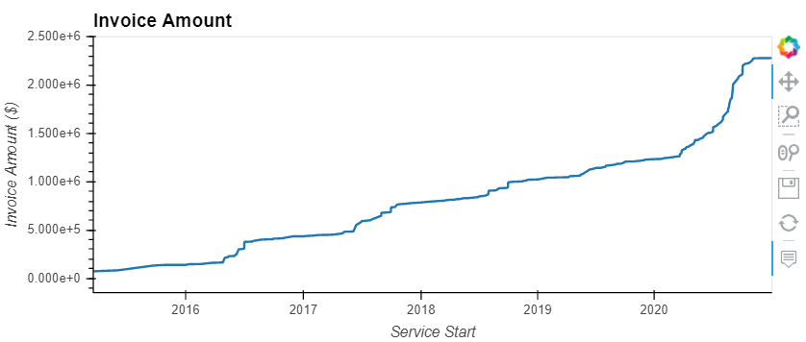
Data Analysis: General Analysis
Aggregate Sales (Invoice Amount, $) 2015 – 2020
Notes:
JONATHAN
-Explain plot used here
-Again same scenario subscription sales highest in 2020 in the 5 year period
-Explain code used to plot these two block charts
- Identify what the objective of the plot is-period & invoice
- conclusion?
a year 2020 showed highest returns/subscription sales- any correlation with the pandemic-more on this in the key recommendation slide
b subscription highest average is in the month of August-any correlation with school/college calendar?

Slide 15
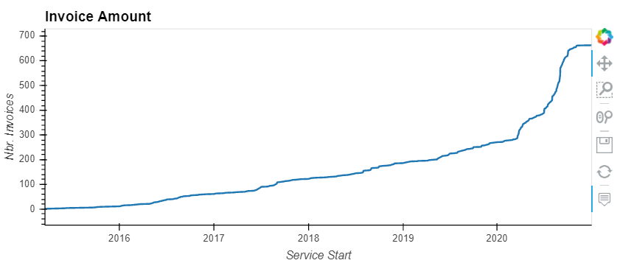
Data Analysis: General Analysis
Sales (Number of Invoices) 2015 – 2020
Notes:
JONATHAN
-Explain plot used here
-Again same scenario subscription sales highest in 2020 in the 5 year period
-Explain code used to plot these two block charts
- Identify what the objective of the plot is-period & invoice
- conclusion?
a year 2020 showed highest returns/subscription sales- any correlation with the pandemic-more on this in the key recommendation slide
b subscription highest average is in the month of August-any correlation with school/college calendar?

Slide 16
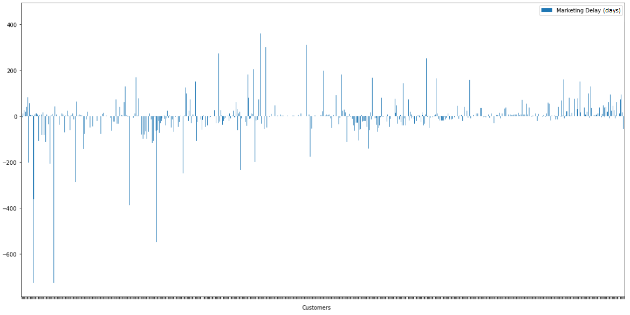
Data Analysis: Conversion Rate Analysis
(c) “Is the company targeting the highest-responding customers?”
Notes:
IBRAHIMA
This plot shows the delay between marketing contact and a purchase.
Fastest-responding customers can be quickly identified.
- Data sources require more investigation.

Slide 17
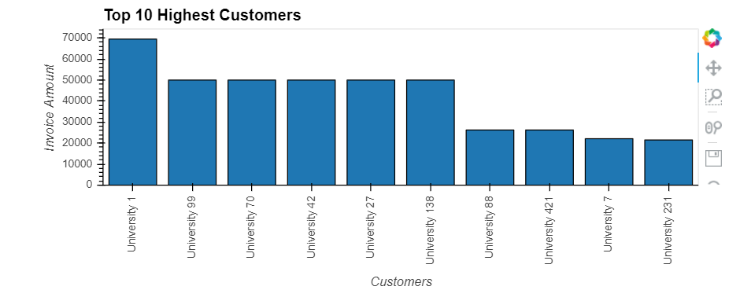
Data Analysis: Conversion Rate Analysis
(c) “Is the company targeting the highest-responding customers?”
(g) “How are the highest paying and highest responding customers identified and classified?”
Top 10 Paying Customers(2015 – 2020)
Notes:
IBRAHIMA
Top 10 paying customers have been identified.
Focusing on what makes these customers stand out can lead to better product adoption.

Slide 18
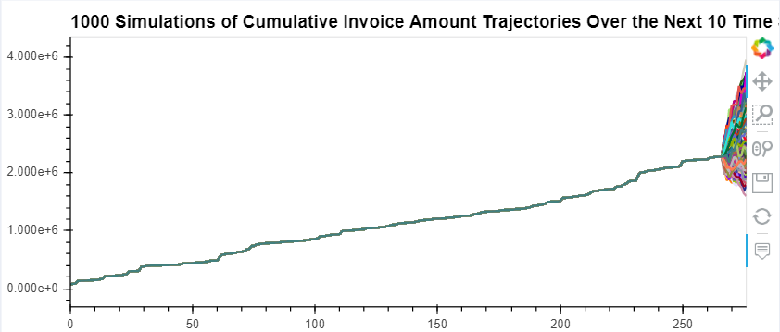
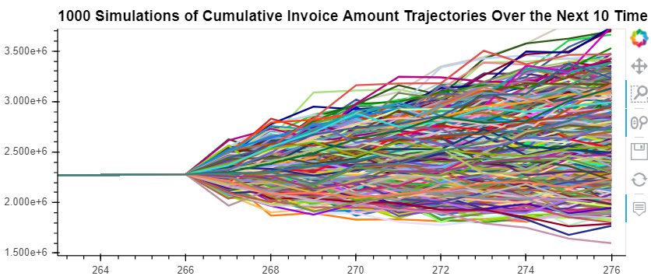
Data Analysis: Sales Forecasting Analysis
(j) “What is a likely projected range of future sales?”
Notes:
MILAD

Slide 19
Data Analysis: Sales Forecasting Analysis
(j) “What is a likely projected range of future sales?”
Sales projections computed using a legacy method are available for comparison to the Monte Carlo simulation. (proprietary)
Sales Potential: Future earnings potential may or may not be correlated with historical trends.
Notes:
MILAD
- There are two approaches: Legacy and monte-carlo.

Slide 20
Data Analysis: Customer & Market Analysis
(e) “What market penetration does the company have into potential customers?”
(f) “What market penetration does the company have regionally?”
Notes:
JACINTA & IBRAHIMA
- Read the questions.

Slide 21
Data Analysis: Customer & Market Analysis
Total market capture computed based on current vs. potential customers:
Total Market Capture Report:
The number of paying customers is 719
The number of potential customers is 3835
Market penetration is 18.748370273794002 %
Notes:
JACINTA & IBRAHIMA
- There are many opportunities in the market, as only 18% is captured.

Slide 22
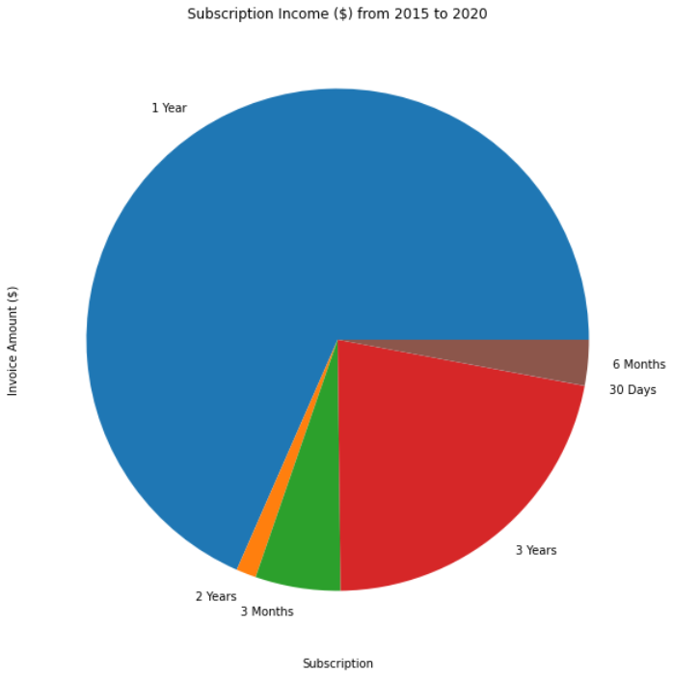
Data Analysis: Customer & Market Analysis
Subscription Earnings Breakdown
Notes:
IBRAHIMA & JONATHAN & JACINTA
-Don’t waste time with 30-days or 2 year subscription.
-Explain plot used here
-Again same scenario subscription sales highest in 2020 in the 5 year period

Slide 23
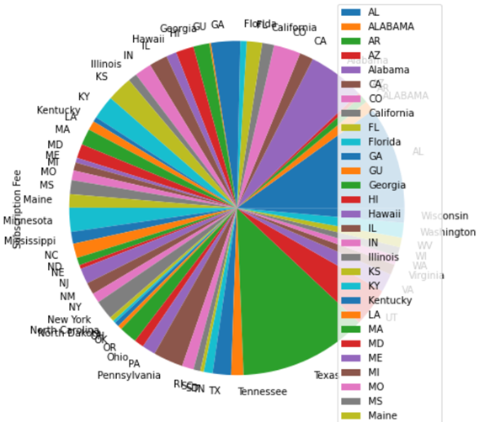
Data Analysis: Customer & Market Analysis
Customer Grouping by State
Notes:
IBRAHIMA & JONATHAN & JACINTA
- States with lower sales can be targeted to increase sales.
-Explain plot used here
-Again same scenario subscription sales highest in 2020 in the 5 year period

Slide 24
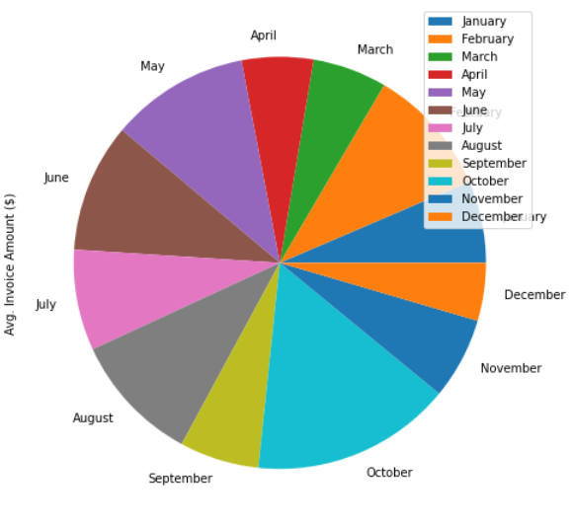
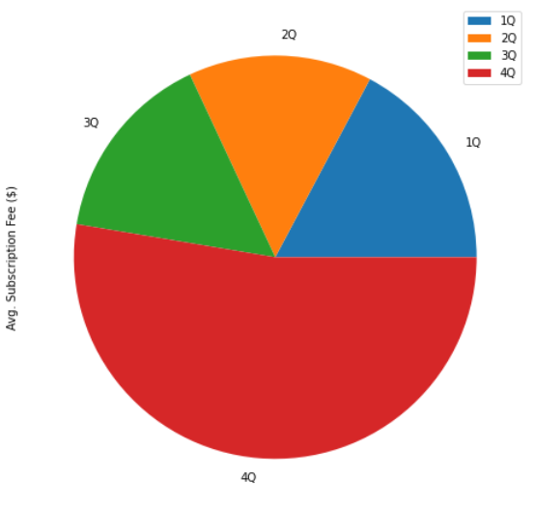
Data Analysis: Customer & Market Analysis
Subscription Type Breakdown
Notes:
IBRAHIMA & JONATHAN & JACINTA
- The most important time of year to get sales is during the 4th quarter in the month of October.
-Explain plot used here
-Again same scenario subscription sales highest in 2020 in the 5 year period

Slide 25
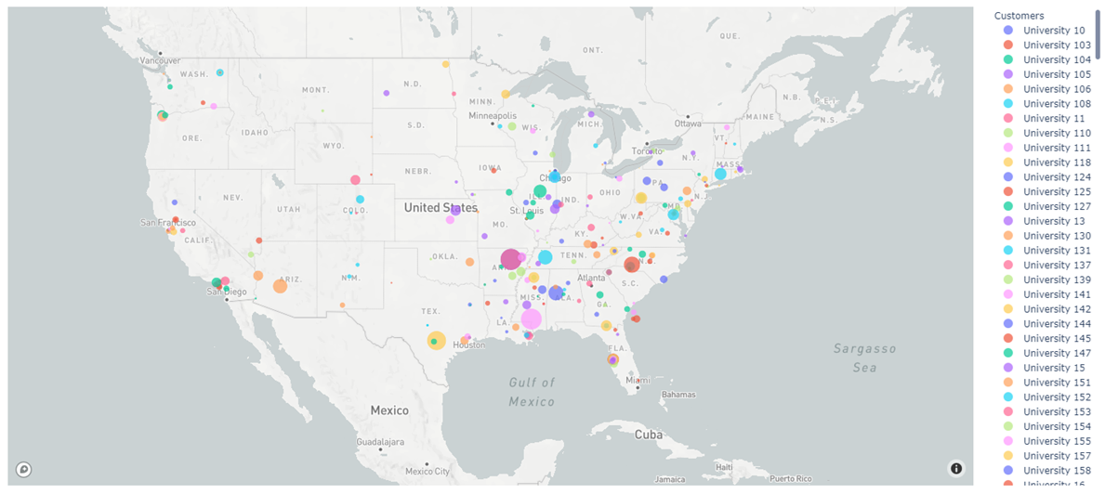
Data Analysis: Customer & Market Analysis
Geographic Customer Capture – U.S.
Notes:
MILAD
coding used mapbox api and visualization
-shows the mean invoices geographically
-shows customers subs are more in the East Coast, there is opportunity to expand in midwest e.g nothing in Idaho,Montana, Utah, California-what recommendations

Slide 26
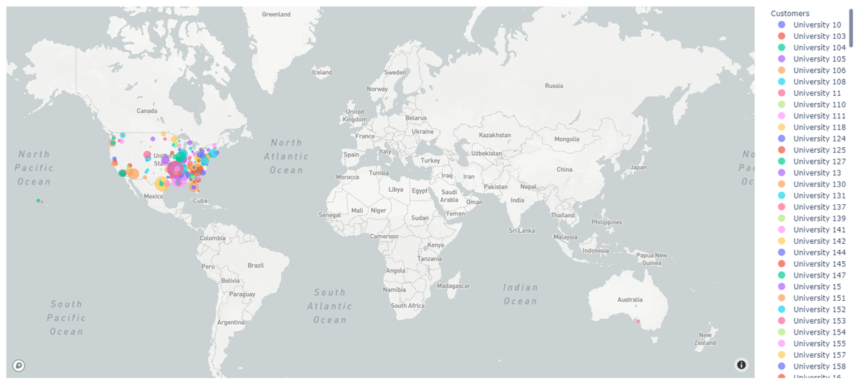
Data Analysis: Customer & Market Analysis
Geographic Customer Capture - World
Notes:
MILAD
- Mapbox api
shows geographical location of customers from the global map- latitude & longitude
shows customers are limited to only to North America concentrated mostly in East Coast

Slide 27
Discussions & Key Conclusions
(h) “What lessons have been learned during the analysis?”
A clear increase in sales occurred in 2020, which may be associated with pandemic-related factors. Moving forward, special care should be taken to:
Look for factors that led to the highest-responding customers, and focus on further expansion.
Even with the massive 2020 expansion in sales, much of the customer base remains untapped; the recommendation is to market to potential customers that are unaware of the product.
The current product offering contains limited complexity and associated products; look for additional related products and services that can be marketed for add-on sales.
Notes:
JONATHAN

Slide 28
Discussions & Key Conclusions
(i) “What recommendations are suggested to ensure increased future sales?”
Target marketing communications to customers who have a historically higher conversion rate, number and value of purchases.
Current subscriptions automatically expire; consider automatically re-purchasing subscriptions at expiration.
Notes:
JONATHAN

Slide 29
Questions?
Q & A
Notes:
ALL

